Slide 1
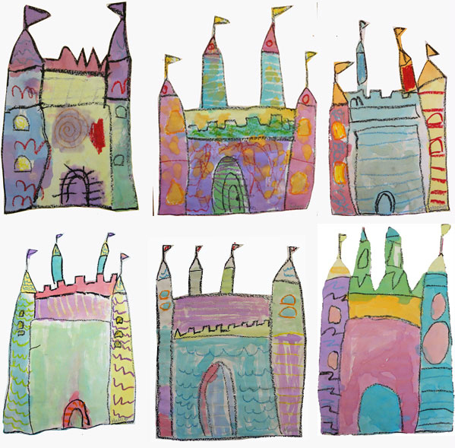
Castles
Mrs Brown • Art ®
Pencil
Oil Pastell
Watercolor paint
First make the towers!
Squares/Rectangles
Triangles.
Lines
Details: flags/windows
Texture/Bricks
Objective: Create a castles that show an understanding of texture, pattern, and watercolor resist techniques

