Slide 1
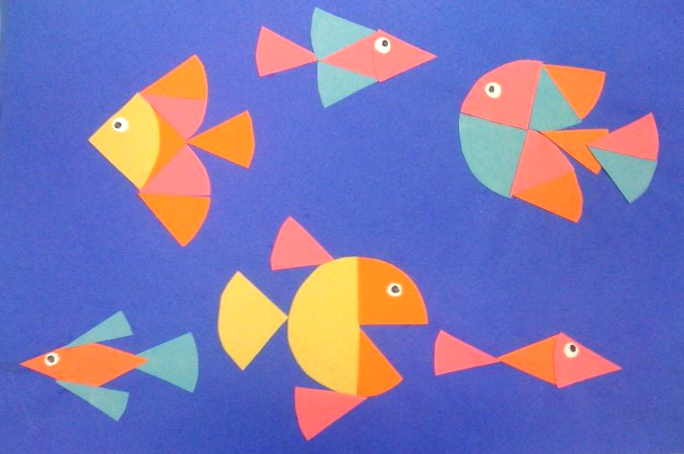
Fraction Fish
Mrs Brown • Art ®

Slide 2
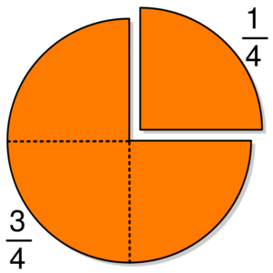
Fraction Fish
Mrs Brown • Art ®

Slide 3
Fraction Fish
Mrs Brown • Art ®
To cut a fraction, cut a circle as a whole.
The fold the paper in half, and cut on the fold line.
Then fold in half again, and cut on that fold line, etc, etc…

Slide 4
Fraction Fish
Mrs Brown • Art ®
Trace and cut five whole circles.
Leave one as a whole. Cut one circle in 1/2 Cut one circle in 1/4 Cut one circle in 1/8 The last one is your choice
Create fish, seaweed, and under sea creatures from your fractions.
You can get more paper too!

